Slide 1
Analyzing Amazon Sales data
By – Savio Rebello

Slide 2
Objective
The objective of this project is to conduct ETL (Extract-Transform-Load) on a dataset sourced from Amazon to analyze sales trends at various granularities: month-wise, year-wise, and yearly-month-wise. Through this analysis, key metrics and factors influencing sales performance will be identified. The project aims to unveil meaningful relationships between attributes within the dataset, providing actionable insights for sales management to optimize distribution methods, reduce costs, and enhance profits in response to increasing competition and evolving market dynamics.

Slide 3
Problem Statement
Sales management has gained importance to meet increasing competition and the need for improved methods of distribution to reduce cost and to increase profits. Sales management today is the most important function in a commercial and business enterprise. Do ETL: Extract-Transform-Load some Amazon dataset and find for me Sales-trend -> month-wise, year-wise, yearly_month-wise Find key metrics and factors and show the meaningful relationships between attributes. Do your own research and come up with your findings.

Slide 4
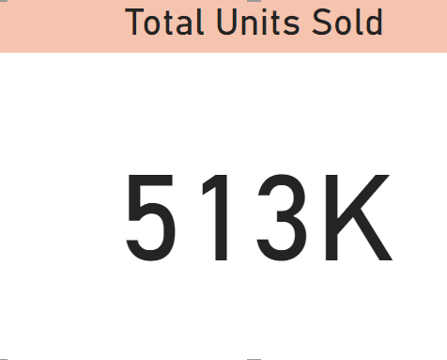
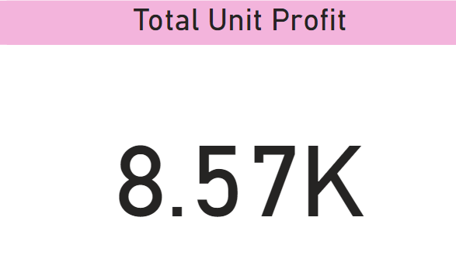
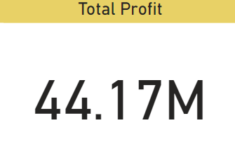
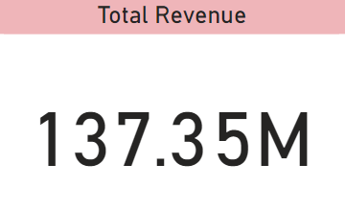
Key Insight
A quick insight for 2010 to 2017 amazon sales

Slide 5
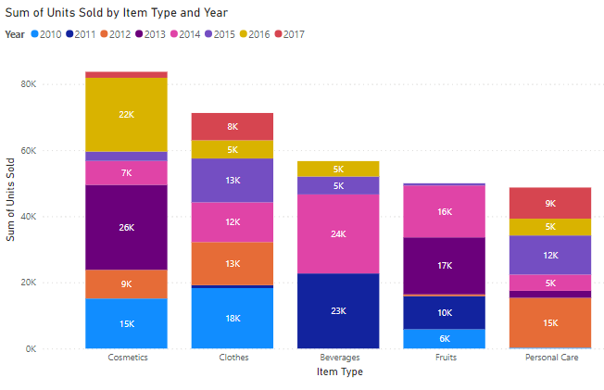
Top 5 most sold Items

Slide 6
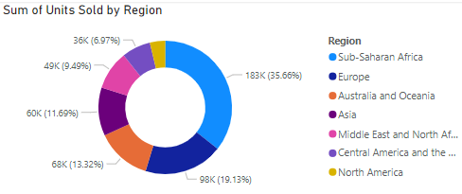
Revenue Categorized By Countries

Slide 7
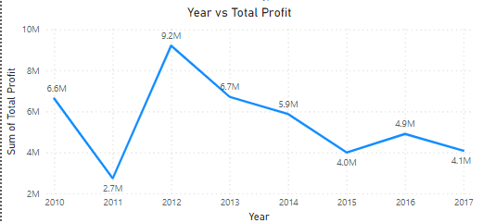
Yearly Sales Trend by Profit

Slide 8
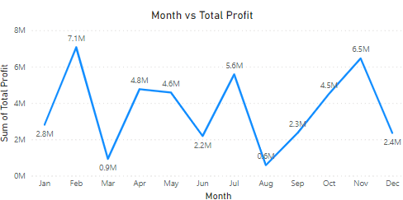
Yearly Sales Trend by Profit

Slide 9
Conclusion
1. In the top 5 units sold Cosmetics item type has the highest unit sold , 2010 – 15 k , 2012-9k, 2013-26k, 2014-7k, 2015-28k, 2016-22k, 2017-1k units sold.
2. In number of units sold by region Sub-Saharan Africa has most unit sold with 183k(35.66%).
3. In yearly profit 2012 has the highest profit with 9.2M.
4. In monthly profit February has the highest profit with 7.1M.

